Slide 1
Lecture 9 Self-Balancing Trees
Department of Computer Science
Hofstra University

Slide 2
AVL Tree: Inserting the sequence: 1,2,3,4,5,6,7
1
2
2
Insert 1,2,3
2
Left rotation
Insert 4,5
3
1
3
1
3
4
Left rotation
(2 is lowest unbalanced node.)
2
2
4
5
Left Rotation
Insert 6
1
4
1
4
2
5
3
5
3
5
3
6
1
6

Slide 3
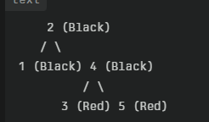
Red-Black Tree: Inserting the sequence: 1,2,3,4,5,6,7
1
2
2
Insert 1,2,3
2
Left rotation
Insert 4,5
1
3
1
3
3
4
2
2
2
2
Left rotation
Recolor
Recolor
Recolor
Insert 5
1
4
3
3
1
3
1
1
3
5
4
4
4
5

Slide 4
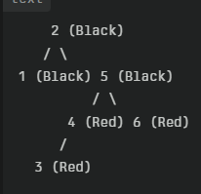
2
2
2
Insert 6
Left rotation, recolor
1
4
1
4
1
5
3
5
3
5
4
6
6
3

Slide 5
Left rotation
(2 is lowest unbalanced node.)
2
4
Insert 5
1
4
2
5
3
5
3
6
1
6

Slide 6
AVL Tree: Inserting the sequence: 1,2,3,4,5,6,7
4
4
Left rotation
(5 is lowest unbalanced node.)
4
Insert 7
5
5
2
6
2
2
6
6
1
3
5
7
1
3
1
3
7

Slide 7
AVL Tree
Create an AVL Tree by inserting the sequence: 45, 70, 35, 3, 74, 25, 81, 60. Draw a new figure whenever you do a rotation.
Notes:
This is the kink case

Slide 8
AVL Tree: Inserting the sequence: 45, 70, 35, 3, 74, 25, 81, 60
45
45
Left/right rotation
Insert 81
35
70
25
70
Insert 45, 70, 35, 3, 74, 25
3
74
3
35
74
25
45
45
45
Left rotation
Insert 60
25
70
25
74
25
74
3
35
74
3
35
70
81
3
35
70
81
81
Insertion Practice randerson11
https://www.youtube.com/watch?v=kcXKAhsJKDg
60
Notes:
This is the kink case

Slide 9
AVL Tree
Create an AVL Tree by inserting the values: 45, 70, 35, 3, 74, 25, 81, 60. Draw a new figure whenever you do a rotation.
Notes:
This is the kink case

Slide 10
AVL Tree: Inserting the sequence: 9, 15, 20, 8, 7, 13, 10
9
15
15
Left rotation
Insert 8, 7
Insert 9, 15, 20
<
15
<
9
20
9
20
20
8
7
AVL Tree – Insertion Lalitha Natraj
https://www.youtube.com/watch?v=CdGVkgMuq_4

Slide 11
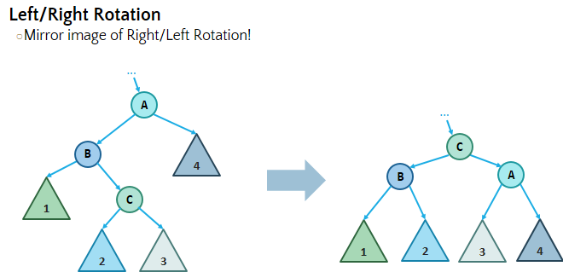
AVL Tree: Inserting the sequence: 9, 15, 20, 8, 7, 13, 10
15
15
15
Right rotation
Insert 13
9
20
8
20
8
20
8
7
9
7
9
7
13
9
9
Insert 10
8
15
8
15
7
13
20
7
13
20
Left/right rotation
(15 is lowest unbalanced node.)
10

